Slide 1
Welcome to R/Medicine 101: Intro to R for Clinical Data
Stephan Kadauke
R/Medicine 2022
Notes:
Start 11:02 AM
Hello and welcome to the R/Medicine pre-conference workshop Intro to R for Clinical Data!

Slide 2
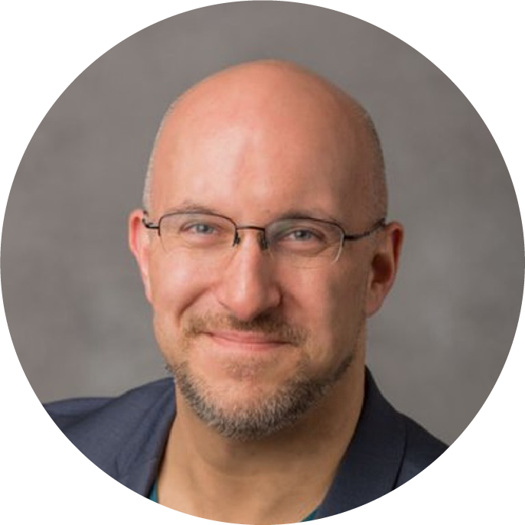
Stephan
Notes:
I'm Stephan Kadauke, dialing in from Philadelphia. I'm the Chair of R/Medicine 2020 Organizing Committee and am leading this workshop. I am an Assistant Professor of Pathology and Laboratory Medicine at the Children’s Hospital of Philadelphia.

Slide 3

Notes:
I’ve been coding in R for 10+ years, and I’m an RStudio Certified trainer.
I have taught R to physicians and other healthcare workers at the Harvard Massachusetts General Hospital, at the University of Pennsylvania, and at various conferences, both online and offline.

Slide 4
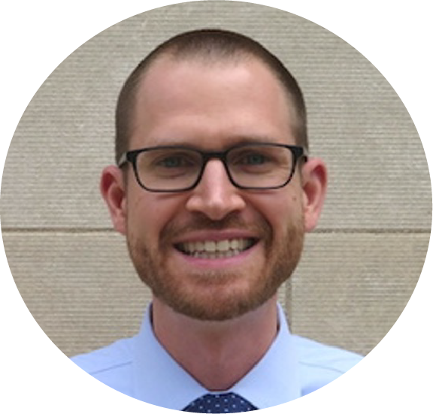
Joe
Notes:
I am joined today by two co-instructors. Joe Rudolf is an Assistant Professor of Pathology at the University of Utah.

Slide 5
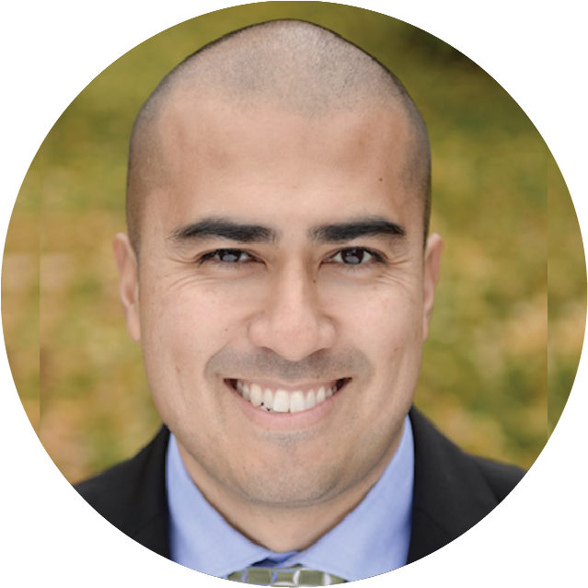
Patrick
Notes:
And Patrick Mathias. …

Slide 6
Introducing the TAs!
Rich Hanna
Jaclyn Janis
Notes:
And we’re fortunate to have a large number of TAs to help with the course.

Slide 7
Orientation to the Technology

Slide 8

Main session vs Breakout rooms
Webinar-style
100+ participants
Mic off
Camera off
Meeting-style
10-15 participants / room
Mic on
Camera optional
Notes:
The main part of the workshop will be webinar style, with everyone in one big session, and participants will be muted and cameras off. We are recording the main session for replay.
We will have two breakout sessions that will each be led by one of the TAs. For the breakouts, we encourage you to participate by turning on your microphone. We also encourage you to turn on your camera, if your are comfortable, but that's completely up to you. We won't record breakout sessions.

Slide 9
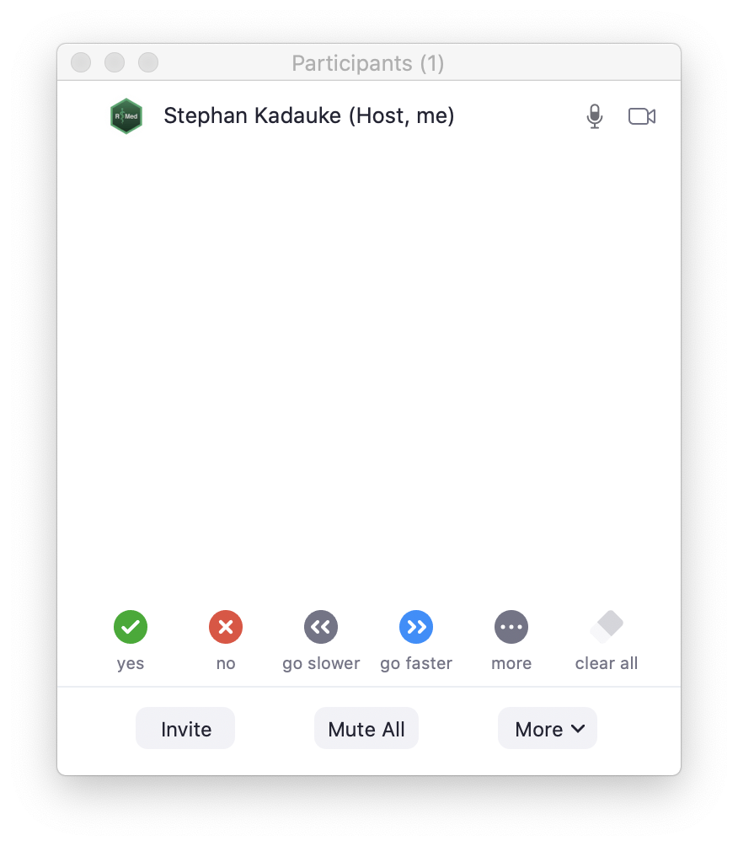
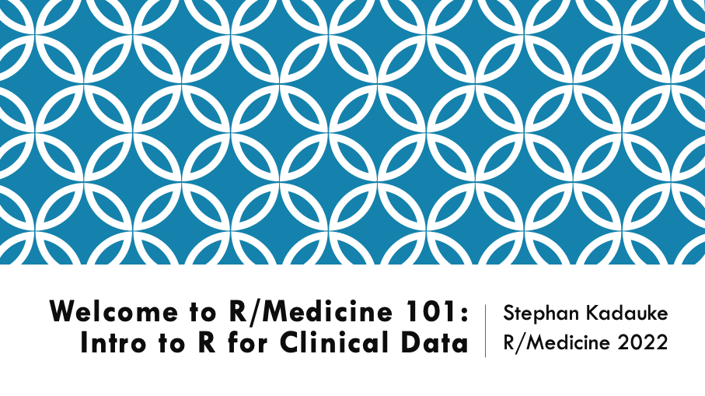
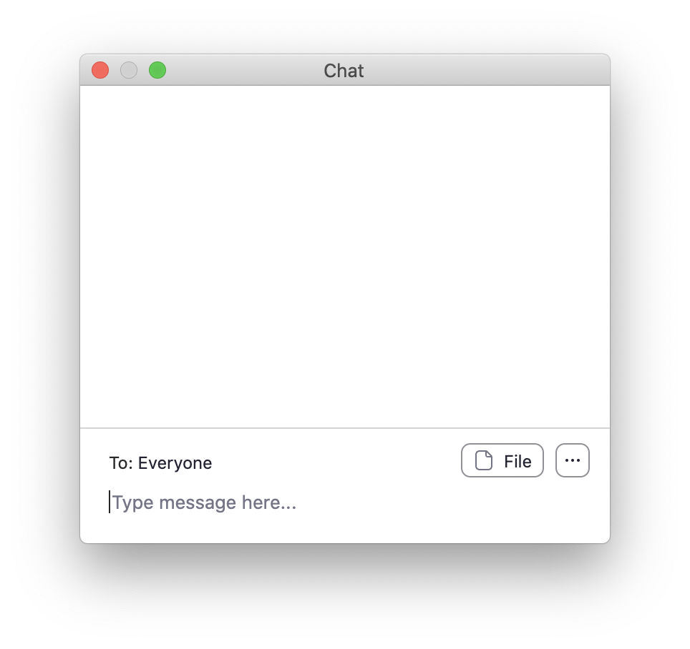
Notes:
This is the main Zoom window. On the bottom you should be able to see two buttons - Participants and Chat.
Click on these buttons now to open the Participants and Chat window, and place those windows somewhere you can see, if necessary by making your main Zoom window a little smaller.
**
**

Slide 10
Non-verbal feedback
Notes:
We will make heavy use of the Non-verbal feedback functionality of Zoom. At various points, I will ask you to click "Yes" to let me know I can keep going. What I mean by that is to click the green circle with the check mark in the Participants window.

Slide 11
Chat window
Notes:
We will use the Chat window as the primary communication tool, primarily to get help if you get stuck with a technical issue. Please note that the presenter can't present and monitor the chat at the same time, so please don't send me private messages. Instead, post to Everyone, briefly describing the problem you have, and you will be helped by one of our TAs.
I also want to set expectations for help here. We have more than 100 participants today, and so please only ask for help if you need technical assistance with Zoom or the training environment. If you have a question about the material, we encourage you to write it down and ask during the breaks, or after the workshop.

Slide 12
Your Turn #1
Click the “yes” button in the Participants window.
Then write your location (city, country) in the Chat window.
Notes:
This brings us to the first interactive exercise!
...

Slide 13
Orientation to the Course

Slide 14
The Data Analysis Pipeline
Notes:
This in a gentle introduction to data science designed for healthcare professionals and clinical researchers who don't have a background in programming. This slide shows a high-level conceptual framework of the most important steps of the data analysis process. You always start by importing data and cleaning or "tidying" it up. Then you start an iterative process of exploratory data analysis, which usually requires some data transformation. The main engines of knowledge generation are visualization and modeling. Finally, you need to communicate your results. W
We will introduce the basics of all of these steps today, with the expection of modeling, which is the focus of Alison Hill's 201 level course.

Slide 15
Lecture slides
Notes:
We will introduce new concepts with lecture slides

Slide 16
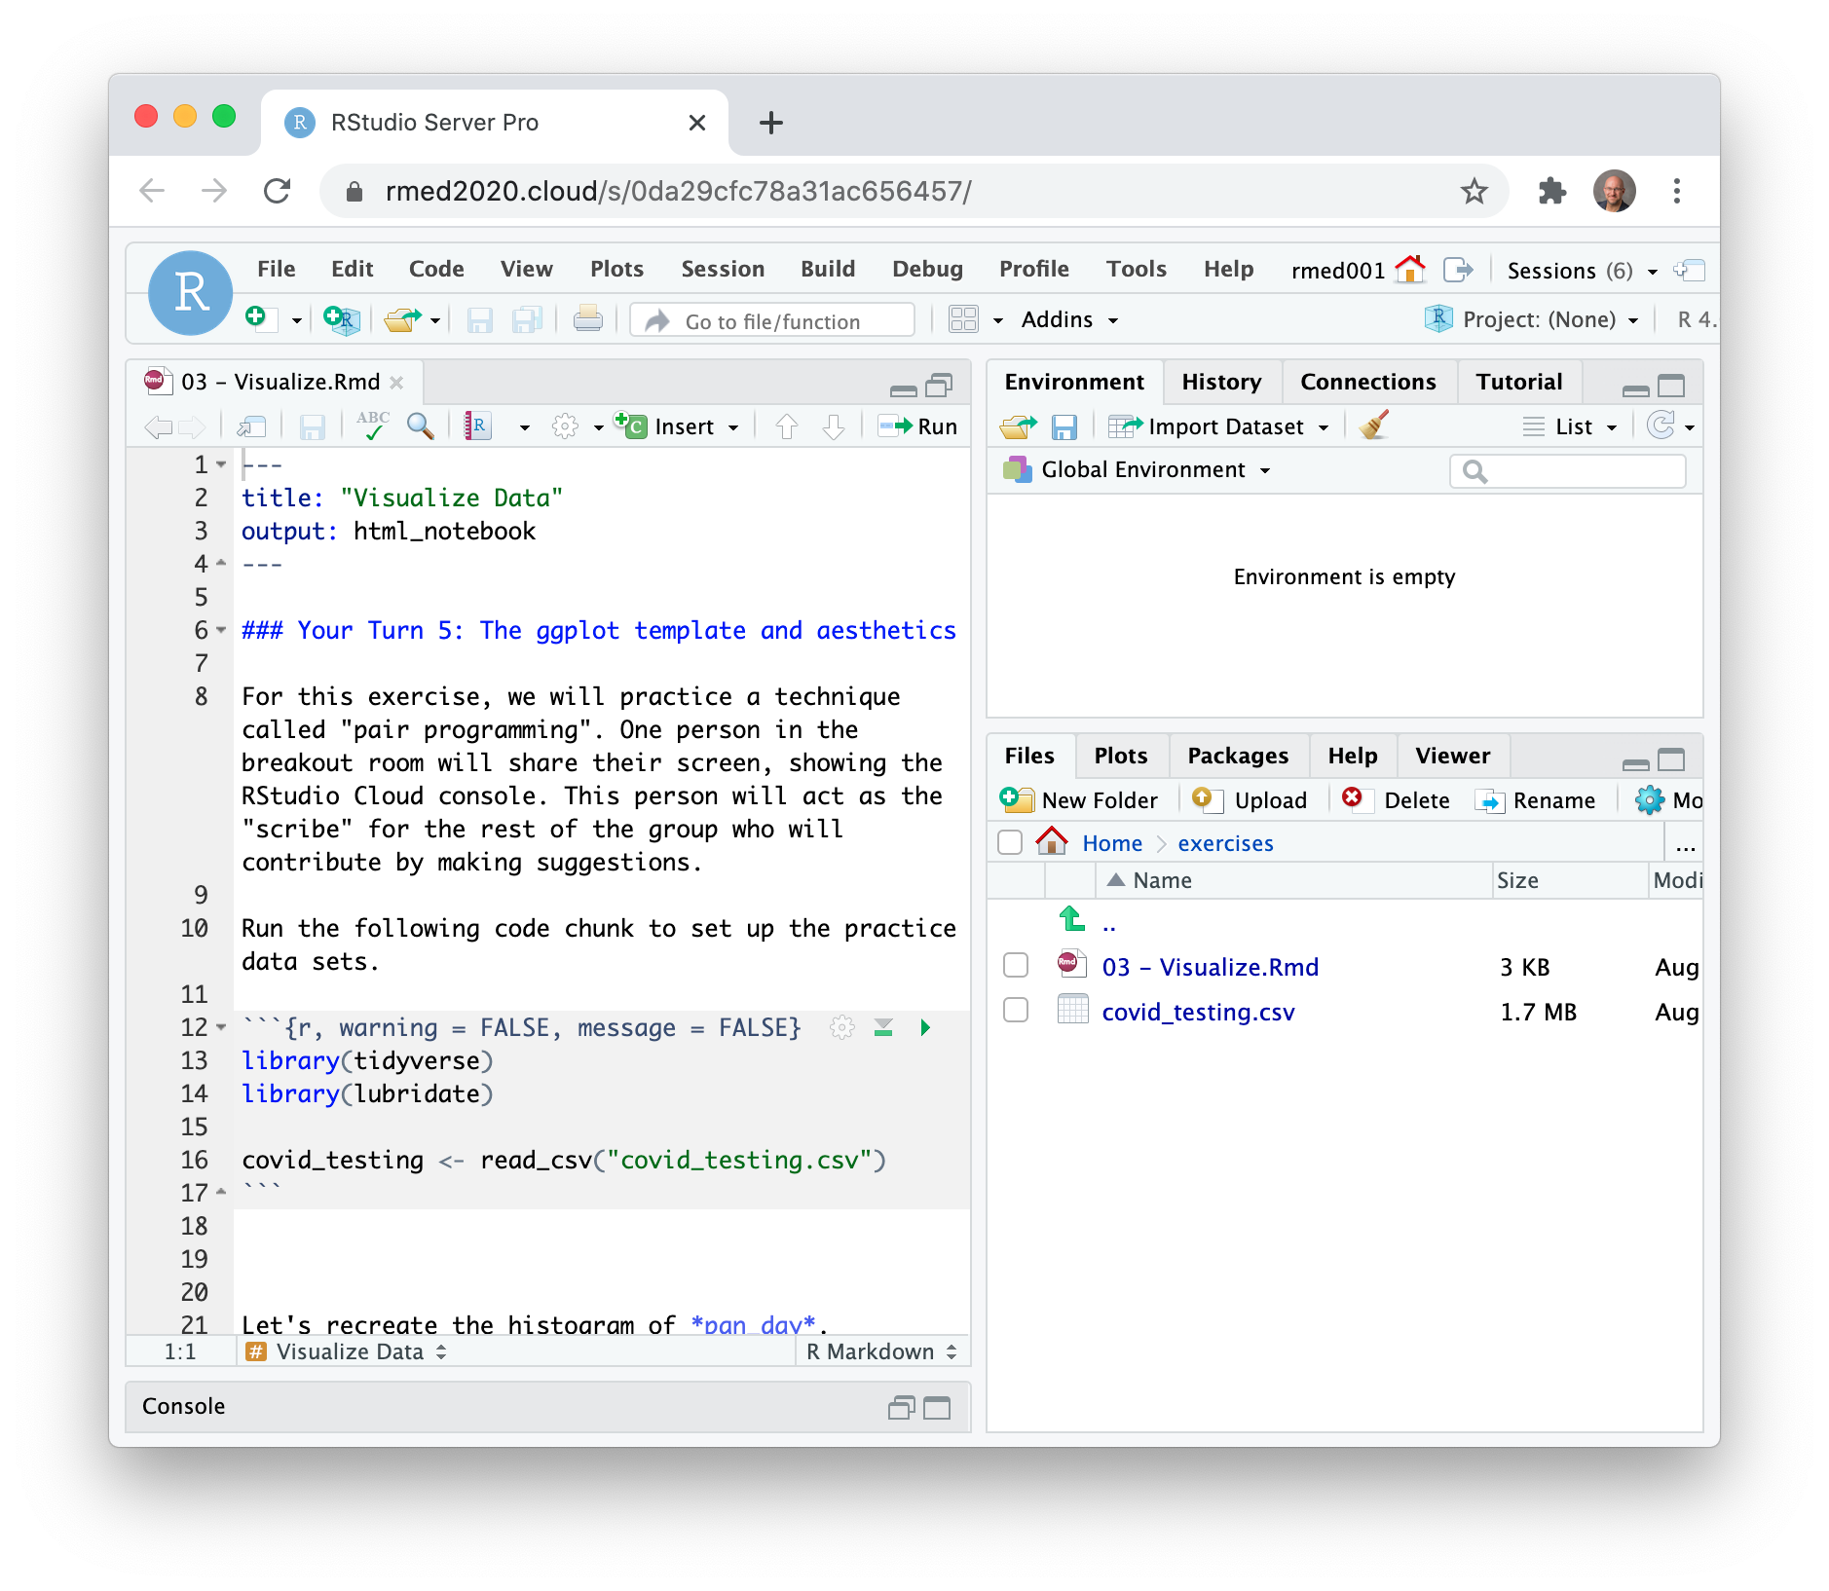
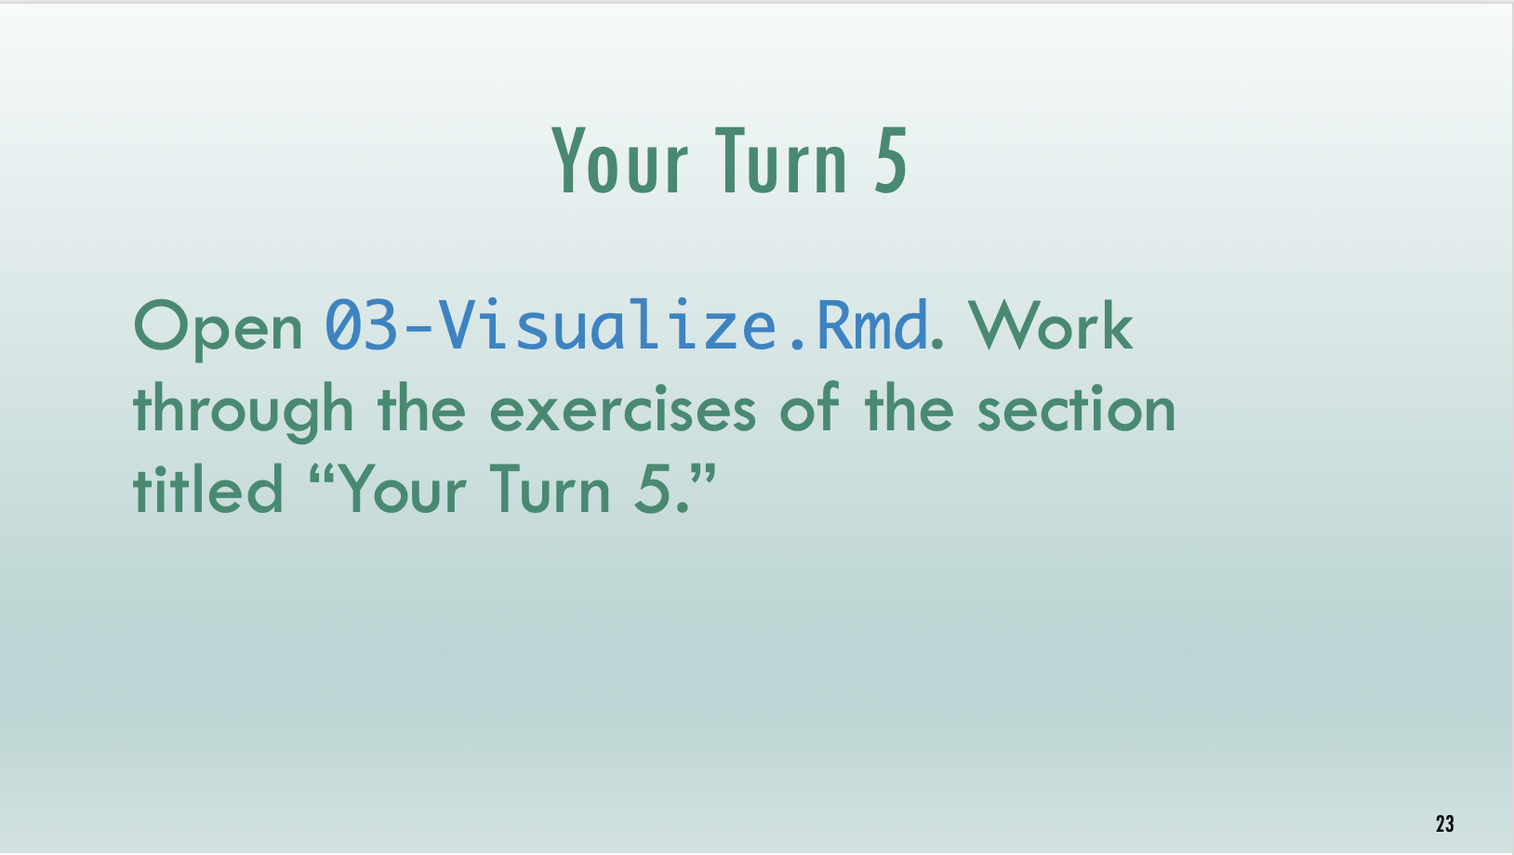
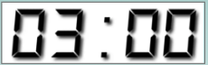
Timed interactive coding exercises
Notes:
And then practice these new skills with timed interactive coding exercises. You will work in a training environment on the web that we specifically set up for this course.
It's important to note that these exercises are timed. It's not essential that you finish each exercise, but it's essential that you try. When the time is up, we ask that everyone stop working and return to the main session. We will then live code the exercise to catch everyone up.

Slide 17
Code of Conduct
Screenshots
Recordings
Photographs
Harassment
https://events.linuxfoundation.org/r-medicine/attend/code-of-conduct/
Notes:
One more serious thing we need to point out, since this is an interactive course - we want to provide a welcoming and supportive environment for all people, regardless of background or identity.
** So we have a strict no harassment policy: this includes abusive, offensive, or degrading language, in writing or voice
** for full CoC please take a look at the main website About > Code of Conduct https://events.linuxfoundation.org/r-medicine/attend/code-of-conduct/
** Also, to respect the privacy of participants, we don’t allow screenshots, recordings, or photographs.
If we find that you violate the code of conduct you may be removed from the course.

Slide 18
Your Turn #2
Meet and greet! We will send you into breakout rooms, where you will have 10 minutes to meet your TA and 10-15 of your fellow participants.
Notes:
TAs will start by introducing themselves, and then “pass the baton” to the next person, who will then also “pass the baton” to the next person, and so on.
For this exercise, we encourage you to turn on your microphone and camera, if you’re comfortable.
At the 10 min mark, we’ll bring everyone back into the main session.

Slide 19
The Data Analysis Pipeline
Visualize
Import
Tidy
Transform
Communicate
Model
Model
Understand
Notes:
This in a gentle introduction to data science designed for healthcare professionals and clinical researchers who don't have a background in programming. This slide shows a high-level conceptual framework of the most important steps of the data analysis process. You always start by importing data and cleaning or "tidying" it up. Then you start an iterative process of exploratory data analysis, which usually requires some data transformation. The main engines of knowledge generation are visualization and modeling. Finally, you need to communicate your results. W
We will introduce the basics of all of these steps today, with the expection of modeling, which is the focus of Alison Hill's 201 level course.

